Slide 1
VIRTUAL LOST AND FOUND BOX

Slide 2
ABSTRACT
Lost and found management has always been a common issue in large organizations, institutions, and public places. Traditional manual methods like maintaining registers or boxes often lead to errors, delays, and unclaimed items. This project introduces a web-based Lost and Found System that simplifies and automates the entire process. It provides an organized, transparent, and efficient way to record, track, and retrieve lost items. Users can easily report lost or found belongings, and all details are stored securely in a database. The system helps administrators verify entries and avoid duplication or fraud. It also reduces administrative workload by providing faster and accurate search results. The digital approach ensures better accessibility, improved efficiency, and higher success rates in recovering items. This project demonstrates the potential of technology to solve simple yet significant real-world problems effectively and sustainably.

Slide 3
EXISTING SYSTEM
The existing system for handling lost and found items is mostly manual and unorganized.
People usually rely on notice boards, announcements, or word of mouth to report or find lost items.
There is no digital platform or centralized database to record lost and found details.
Information about lost items is often not properly maintained and may get misplaced or removed after some time.
The search process is time-consuming and depends heavily on manual checking or luck.
Users have to visit multiple locations (e.g., offices, campuses, police stations) to inquire about their lost belongings.
There is no proper record of found items or proof of ownership for item verification.
Sometimes, duplicate reports or missing information lead to confusion and inefficiency.
Communication between the person who lost and the person who found the item is indirect and often unreliable.

Slide 4
PROPOSED SYSTEM
The proposed system introduces a web-based full-stack application for managing lost and found items efficiently.
Users can report lost or found items online through an interactive interface.
A centralized database securely stores all item details for easy access and retrieval.
The system allows users to search and filter lost and found items using keywords, location, or category.
Automated matching helps identify potential matches between lost and found items.
The admin module manages user data, verifies posts, and ensures data accuracy.
Users receive notifications or updates when a match is found.
The system maintains user authentication and data security to prevent misuse.
It reduces manual effort, making the process faster, reliable, and more transparent.
Cloud-based storage ensures accessibility from anywhere at any time.

Slide 5
ADVANTAGES
Time-Saving: Users can quickly report or search for items without manual visits.
Centralized Platform: All lost and found data is stored in one unified system.
Automated Matching: The system intelligently matches lost and found items.
User-Friendly Interface: Simple design makes it easy for anyone to use.
Data Security: User details and item data are securely stored and protected.
Real-Time Access: Users and admins can access information anytime, anywhere.
Reduced Manual Work: Eliminates paperwork and manual record maintenance.
Transparency: Every report and match process is traceable and verifiable.
Admin Control: Admin can monitor, verify, and manage all entries efficiently.
High Accuracy: Reduces duplication and false reporting of items.

Slide 6
DISADVANTAGES
User Registration Required: Users must create an account before posting or searching items.
Data Accuracy Depends on Users: Incorrect or incomplete information can cause mismatches.
Limited Verification: The system cannot always verify the authenticity of every post.
Technical Maintenance: Requires regular updates and server maintenance.
No Physical Verification: Admins rely on digital evidence instead of in-person validation.
Privacy Concerns: User details must be protected from misuse or unauthorized access.
Initial Setup Cost: Hosting, database setup, and development may incur costs.
Learning Curve: Non-technical users might need basic guidance to use the platform.
Possible Spam Entries: Without strict admin control, false or duplicate entries may occur.
Internet Dependency: The system requires a stable internet connection to function.

Slide 7
HARDWARE REQUIREMENTS
Hardware Requirements
1. Server-Side Requirements
Processor: Intel Core i5 or higher
RAM: Minimum 8 GB
Hard Disk: 250 GB or above
Network: High-speed internet connection
Monitor: 17” LED or above for server management
2. Client-Side Requirements
Processor: Intel Core i3 or higher
RAM: Minimum 4 GB
Storage: 100 GB free space
Display: 15” monitor with 1024×768 resolution
Input Devices: Standard keyboard and mouse
Network: Stable internet connection (Wi-Fi or LAN)
3. Additional Hardware (Optional)
Printer: For printing lost/found reports or receipts
Scanner / Camera: For uploading item images
Backup Device: External hard drive or cloud backup for data security

Slide 8
SOFTWARE REQUIREMENTS
1. Frontend Technologies
HTML5, CSS3, JavaScript for structure and styling
React.js / Angular / Vue.js for interactive user interface
Bootstrap / Tailwind CSS for responsive design
2. Backend Technologies
Node.js / Express.js for server-side scripting
Python (Django / Flask) or PHP (optional alternatives)
RESTful APIs for frontend-backend communication
3. Database
MySQL / MongoDB / PostgreSQL for data storage and retrieval
Supports CRUD operations for lost and found item records
4. Operating System
Windows 10 / 11, Linux, or macOS
Compatible with both server and client environments

Slide 9
MODULE EXPLANATION
1. User Module : Allows users to register, log in, and manage their profiles. Enables posting and viewing of lost or found items.
2. Lost Item Module : Users can submit details of items they have lost. Stores data securely in the lost items database.
3. Found Item Module : Users can report items they have found with images and details. Helps identify and notify the rightful owner.
4. Search & Match Module : Provides search functionality using keywords and filters. Automatically matches lost and found items.
5. Admin Module : Admin manages users, posts, and verifies data authenticity. Handles deletion or modification of false entries.
6. Notification Module : Sends alerts to users about matching lost or found items. Uses email or in-app notifications for instant updates.

Slide 10
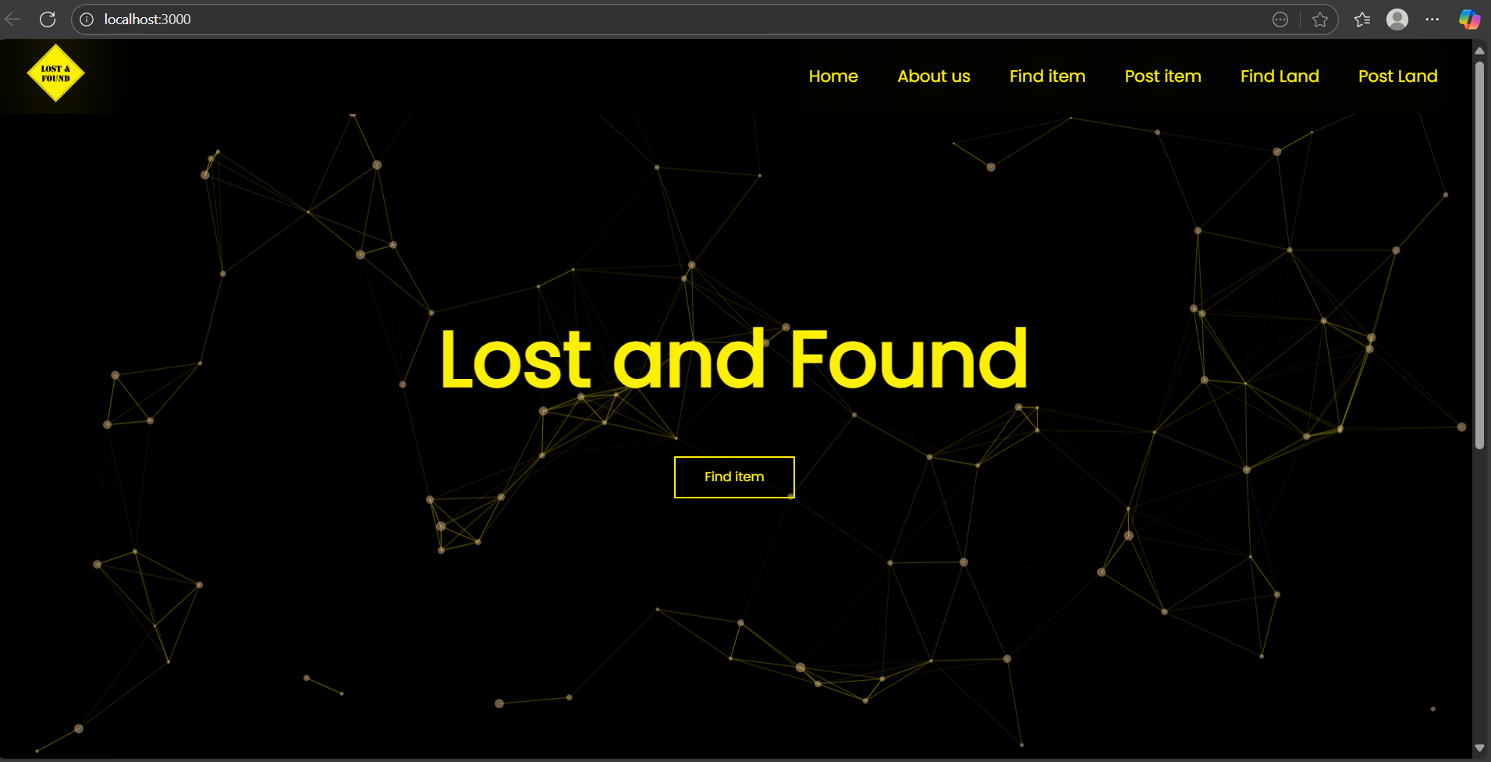
OUTPUT

Slide 11
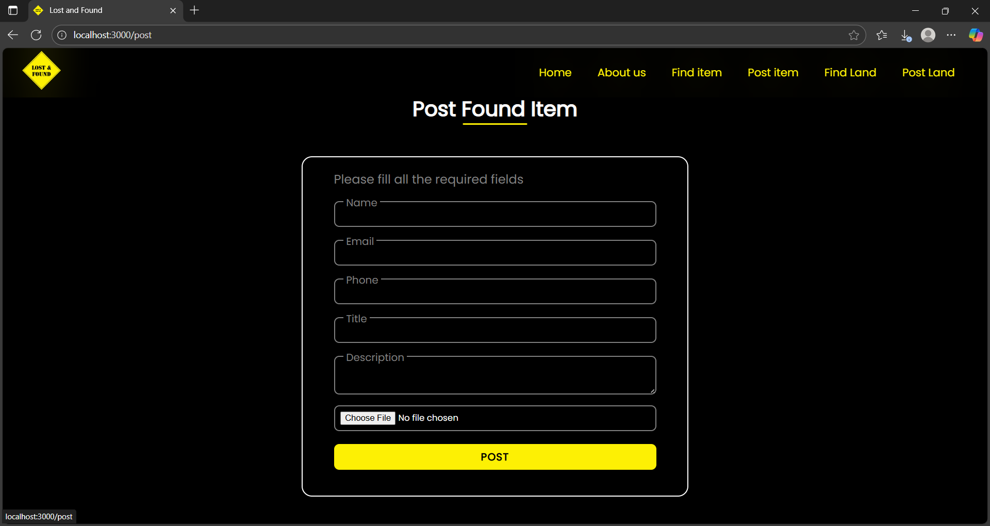

Slide 12
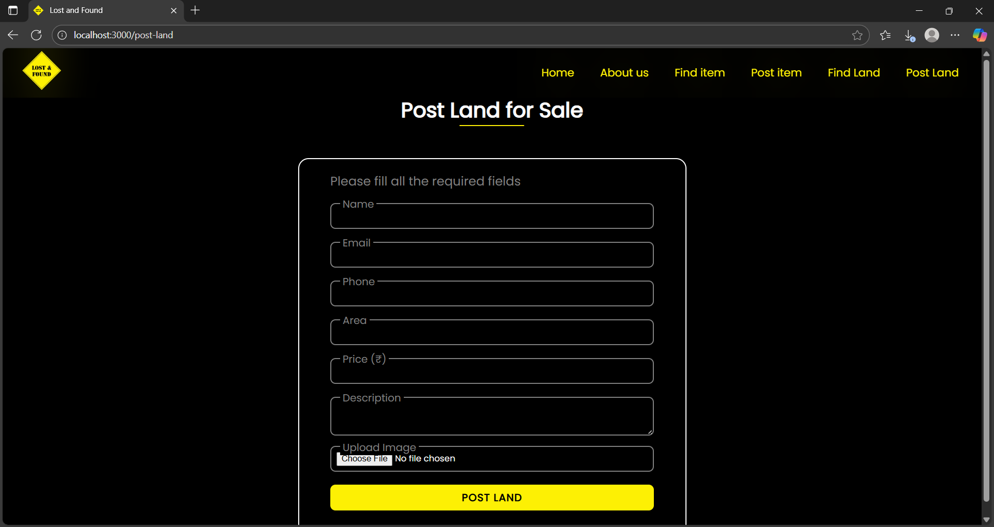

Slide 13
CONCLUSION
In conclusion, the Lost and Found System provides a modern solution to the longstanding challenge of misplaced belongings. It ensures a systematic process of reporting, tracking, and recovering items, reducing human errors and inefficiencies found in manual systems. The project not only saves time but also builds trust among users by offering transparency and reliability. With further development, the system can be scaled into a more advanced platform using mobile applications and AI tools, making it adaptable for large institutions and public use. The project proves the value of technology in real-life problem-solving. It highlights the importance of structured design in building efficient systems. Overall, it bridges the gap between human needs and digital solutions.

